Slide 1


Slide 2
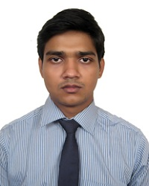
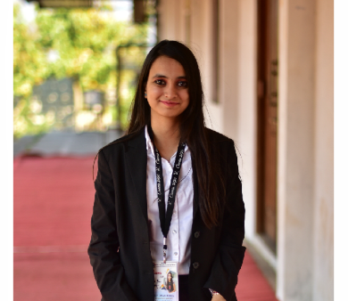
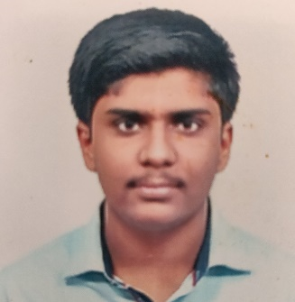
Project Highlights
Project Name : Mobile Banking Application using core Java
Team Size :3
Milind Mohapatra
PS#- 99002670
2009MYSEMB03
B. Tech in ECE
S P Bala Sirisha
PS#- 99002653
2009MYSEMB03
B. Tech in ECE
Anubhav Reddy S
PS#- 99002481
2009MYSEMB03
B. Tech in ECE

Slide 3
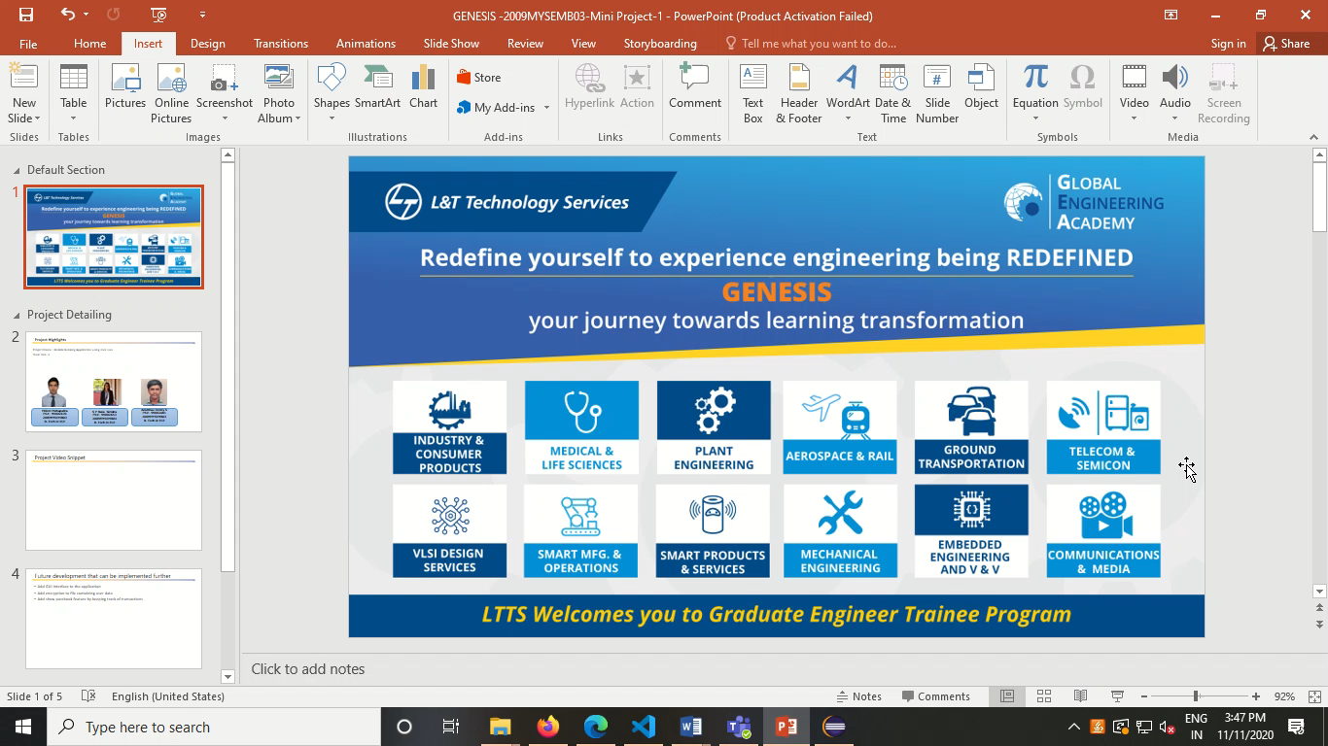
Project Video Snippet

Slide 4
Future development that can be implemented further
Add GUI interface to the application
Add encryption to file containing user data
Add show passbook feature by keeping track of transactions

Slide 5


Thank You !

